Slide 1
Miles Study
By Anthony Davis

Slide 2

Study Question:
How many miles do I drive per day in comparison to the national average?

Slide 3
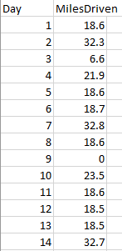
Data Collection
Variables: y(dependent variable) = Number of Miles driven
x(independent variable) = days (numbered 1-14, no skipped days in collection)
Collection Process: I used two apps on my phone, one from insurance and one from the car manufacturer. Double checked with odometer, all values were within .4 miles of each other, used the largest total miles results for testing.
The data was compared to the US average of 13,476 miles a year (taken from the Federal Highway Administration). Or 36.92054 miles per day (13,476/365).

Slide 4
Testing
My overall claim: On average, I drive less than the average American per day.
Null hypothesis(Ho) = I drive the same amount as the average American per day on average
Alternative Hypothesis(Ha) = I drive less than the average American per day as average
Test used = t test

Slide 5
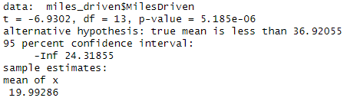

Results
t-value = -6.9302
p-value = 5.185$e^{−6}$
Using a significance level of 0.05:
P-value is 5.185$e^{−6}$ which is less than the significance level. Therefore, we can reject the Ho. The data does provide enough evidence to conclude that mean miles driven by me per day is less than the US average driven per day.

Slide 6
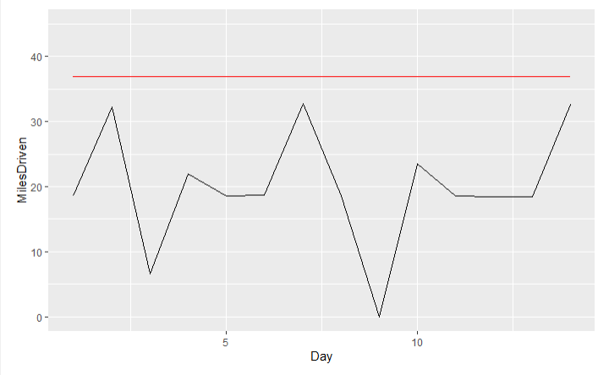
Graph
Black = My miles driven
Red = Average US miles driven

